Slide 1
Introduction To Various Information System
By Hiren Mistry

Slide 2
Various Information System
Business Information System
  Transaction Processing system
  Workflow System
  ERP
Management Information System
Decision Support System

Slide 3
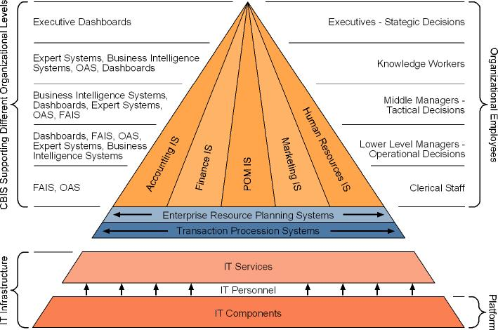
Business Information System
Chart of BIS

Slide 4
Business Information System
Information Systems Support for Organization Employees
  Office automation systems
  Functional area information systems
  Business intelligence systems
  Expert Systems
  Dashboards
Why are Information Systems Important to Organizations & Society
  It will reduce the number of middle managers.
  It will change the manager’s job.
  It impacts employees at work.
  It provides quality-of-life improvements.

Slide 5
Transaction Processing System
Also known as Transaction Processing Monitor
set of information which processes a data transaction in a database system that monitors transaction programs
The spirit of a transaction program is that it manages data that must be left in a consistent state.

Slide 6
Transaction Processing System
Features of TPS
  Rapid response
    Fast performance with a rapid response time is critical.
    the turnaround time from the input of the transaction to the production for the output must be a few seconds or less.
  Reliability
    Many organizations rely heavily on their TPS
    a TPS to be effective its failure rate must be very low.
    quick and accurate recovery must be possible
  Inflexibility
    every transaction to be processed in the same way regardless of the user
  Controlled processing
    All the processing must be controlled by single module or department or user

Slide 7
Workflow System
consists of a sequence of connected steps
It is a representation of a sequence of operations, declared as work of a person, a group of persons, an organization of staff, or one or more simple or complex mechanisms.
seen as any abstraction of real work, segregated in work share, work split or other types of ordering.
may be a view on real work under a chosen aspect
The flow being described often refers to a document that is being transferred from one step to another.
The term workflow is used in computer programming to capture and develop human-to-machine interaction.

Slide 8
Workflow System
Examples of Workflow System
  In military planning, a "concept of operations" is a workflow that defines particular mission types.
  In machine shops, particularly job shops and flow shops, the flow of a part through the various processing stations is a work flow.
  Insurance claims processing is an example of an information-intensive, document-driven workflow.
  Wikipedia editing is an example of a stochastic workflow.
  The Getting Things done system is a model of personal workflow management for information workers.
  In global software development, the concept of follow-the-sun describes a process of passing unfinished work across time zones.
  In Scientific experiments, the overall process (tasks and data flow) can be described as a Directed Acyclic Graph (DAG). This DAG is referred to as a workflow, e.g. Brain Imaging workflows.

Slide 9
Workflow improvement theories
Six Sigma
Total Quality Management
Business Process Reengineering
Lean systems
The Helix Methodology / Helix Factor

Slide 10
Six Sigma
business management strategy originally developed by Motorola, USA in 1981.
seeks to improve the quality of process outputs by identifying and removing the causes of defects (errors) and minimizing variability in manufacturing and business processes.
uses a set of quality management methods, including statistical methods, and creates a special infrastructure of people within the organization ("Black Belts", "Green Belts", etc.) who are experts in these methods.
carried out within an organization follows a defined sequence of steps and has quantified financial targets (cost reduction or profit increase).
originated from terminology associated with manufacturing, specifically terms associated with statistical modeling of manufacturing processes.

Slide 11
Total Quality Management
is a management concept coined by W. Edwards Deming.
is to reduce the errors produced during the manufacturing or service process, increase customer satisfaction, streamline supply chain management, aim for modernization of equipment and ensure workers have the highest level of training.
is often associated with the development, deployment, and maintenance of organizational systems that are required for various business processes.
The main difference between TQM and Six Sigma (a newer concept) is the approach. TQM tries to improve quality by ensuring conformance to internal requirements, while Six Sigma focuses on improving quality by reducing the number of defects and impurities.

Slide 12
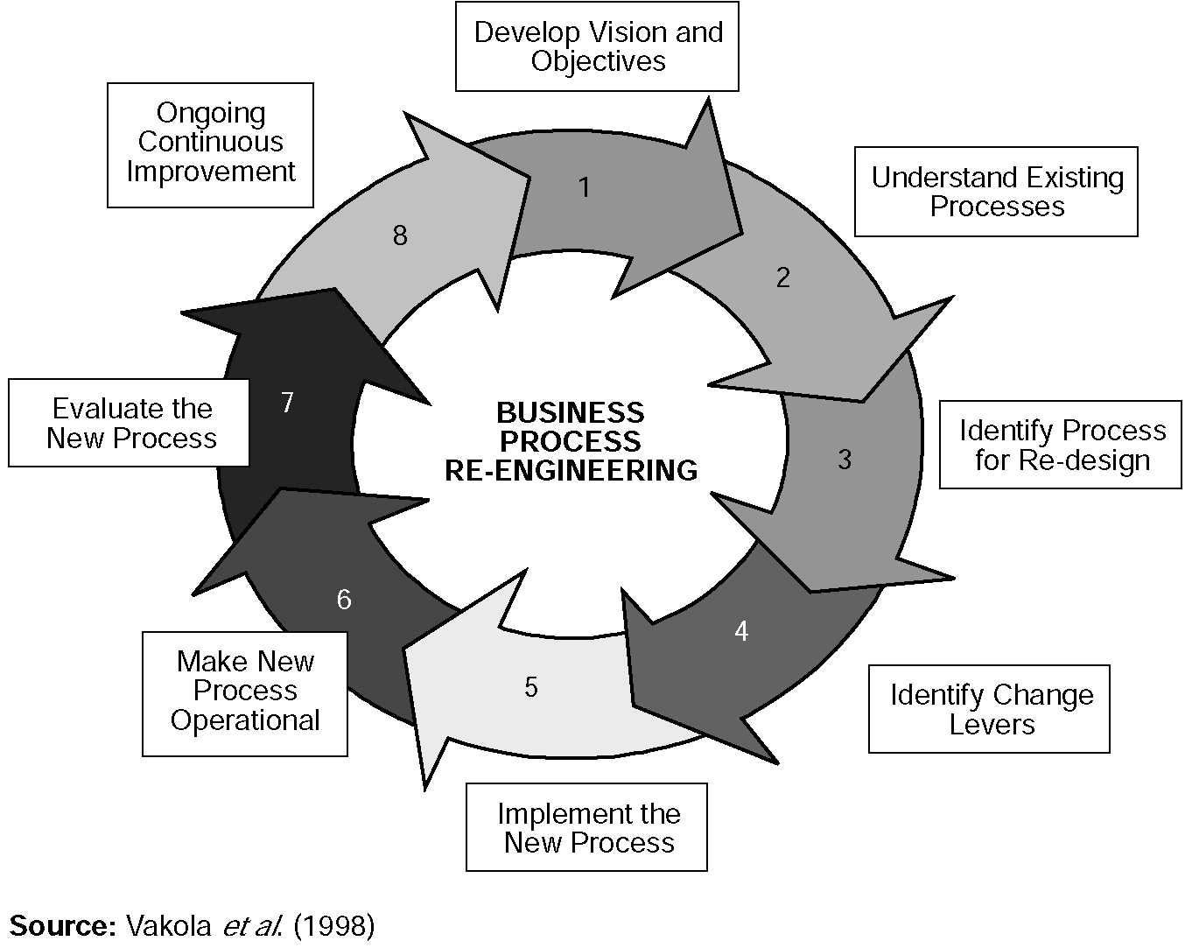
Business Process Reengineering
analysis and design of workflows and processes within an organization.
A business process is a set of logically related tasks performed to achieve a defined business outcome.
Re-engineering is the basis for many recent developments in management.
also known as Business Process Redesign, Business Transformation, or Business Process Change Management.

Slide 13
Lean systems
"Lean," is a production practice that considers the expenditure of resources for any goal other than the creation of value for the end customer to be wasteful, and thus a target for elimination.
is the set of "tools" that assist in the identification and steady elimination of waste.
As waste is eliminated quality improves while production time and cost are reduced.
As waste is eliminated quality improves while production time and cost are reduced. Lean and TPS can be seen as a loosely connected set of potentially competing principles whose goal is cost reduction by the elimination of waste.
These principles include: Pull processing, Perfect first-time quality, Waste minimization, Continuous improvement, Flexibility, Building and maintaining a long term relationship with suppliers, Autorotation, Load leveling and Production flow and Visual control.

Slide 14
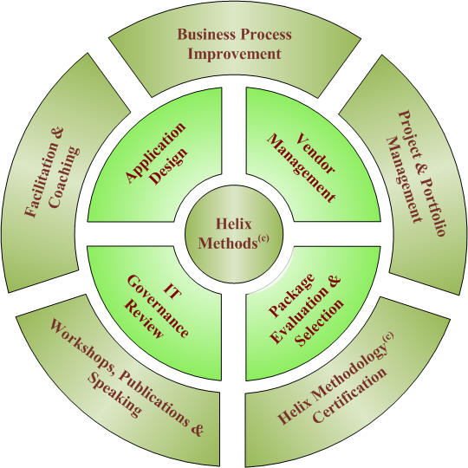
The Helix Methodology / Helix Factor
To improve the way organizations deliver value to their stakeholders by helping them to achieve Strategically Aligned Operational Results.
As a way of bridging the gap between the two, significant effort is being put into defining workflow patterns that can be used to compare different workflow engines across both of these domains

